Slide 1
Learning and Transferring Mid-Level Image Representations using Convolutional Neural Networks
Maxime Oquab 1,∗ Leon Bottou 2 Ivan Laptev 1,∗ Josef Sivic 1,∗
CVPR 2014 ; Technical report (HAL-00911179, Nov. 2013)
He completed my PhD at the University of Oxford.
He is particularly interested in visual search and recognition applied to large image and video collections.

Slide 2

Learning and Transferring
Overview
Introduction
Related work
L and T
Experiments

Slide 3
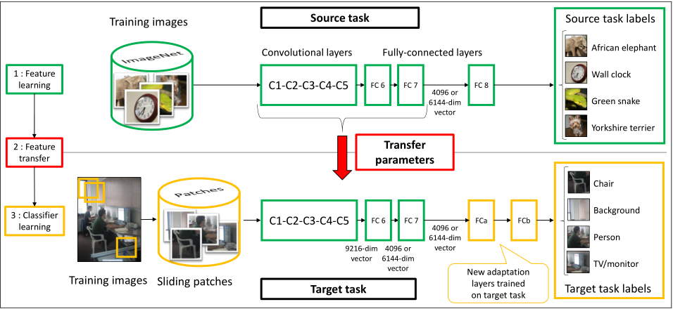
Learning and Transferring

Slide 4

Learning and Transferring
Overview
Introduction
Related work
L and T
Experiments

Slide 5

Introduction
1.The development of a neural network to the convolutional neural network
2.The experiment proved that CNNs are hard to train using small numbers of images
3.In order to solve the “data-hungry” and the difficulty of collecting large-scale image datasets

Slide 6
4.The demonstration of the method itself from object recognition object and localization two aspects.

Slide 7

Learning and Transferring
Overview
Introduction
Related work
L and T
Experiments

Slide 8
Related work
Transfer learning
Visual object classification
Deep Learning

Slide 9
Transfer learning
1)Transfer learning aims to transfer knowledge between related source and target domains [34].
2)The same category, the different conditions
Visual object classification
The goal of this work is to show that convolutional network layers provide generic mid-level image representations that can be transferred to new tasks.

Slide 10
Deep Learning

Slide 11

Learning and Transferring
Overview
Introduction
Related work
L and T
Experiments

Slide 12

Learning and Transferring
Two major tasks:
(i) design an architecture that explicitly remaps the class labels between the source and target tasks
(ii) develop training and test procedures, inspired by sliding window detectors, that explicitly deal with different distributions of object sizes, locations and scene clutter in source and target tasks

Slide 13
Learning and Transferring
Network architecture
Network training
Classification

Slide 14
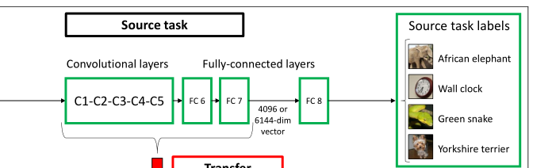
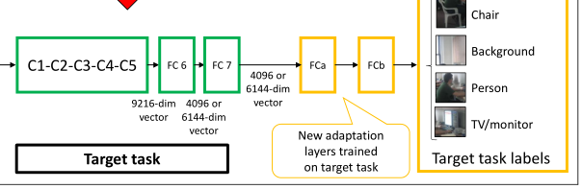
Network architecture
1)For the source task
2)For target tasks

Slide 15
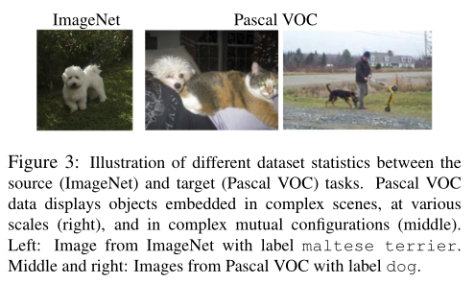
Network training
We employ a sliding window strategy and extract around 500 square patches from each image

Slide 16
(i) Bo overlaps sufficiently with the patch |P ∩ B o | ≥ 0.2|P|,
(ii) the patch contains large portion of the object |P ∩ B o | ≥ 0.6|Bo |
(iii) the patch overlaps with no more than one object.
In the above definitions |A| measures the area of the bound-ing box A.

Slide 17
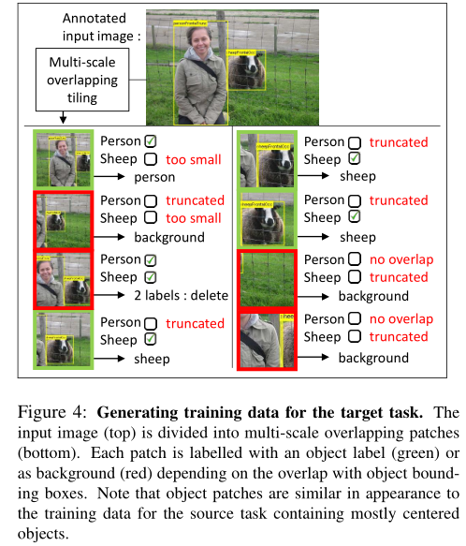


Slide 18
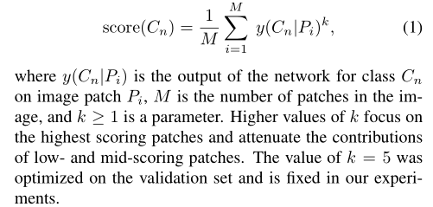
Classification
(I understand that for the whole image)
We use the following aggregation formula to compute the overall score for object Cn in the image

Slide 19

Learning and Transferring
Overview
Introduction
Related work
L and T
Experiments

Slide 20

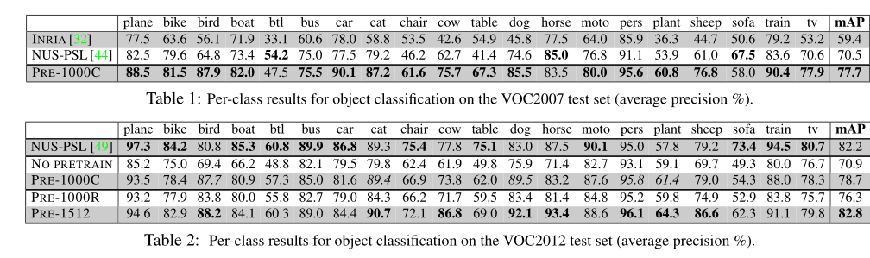
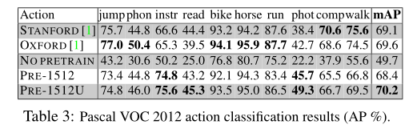
Experiments

